Slide 1
Wine Review Analysis
Danielle Anderson, Eric Simon, Omar Solis, Tali Tesar

Slide 2
About the Data
Retrieved from: https://www.kaggle.com/datasets/zynicide/wine-reviews
Originally from Wine Enthusiast Catalog:
https://www.wineenthusiast.com
Collected November, 2017
Contains approximately 130,000 different wines, including a review of each

Slide 3
Questions to be Answered
What wine has the best value (highest rating for lowest price)?
What countries produce the highest quality and highest price wines?
What are the different ways in which wine can be described and how do these descriptions affect price?
What different names of fruits are used most commonly in reviews in general and by country?

Slide 4
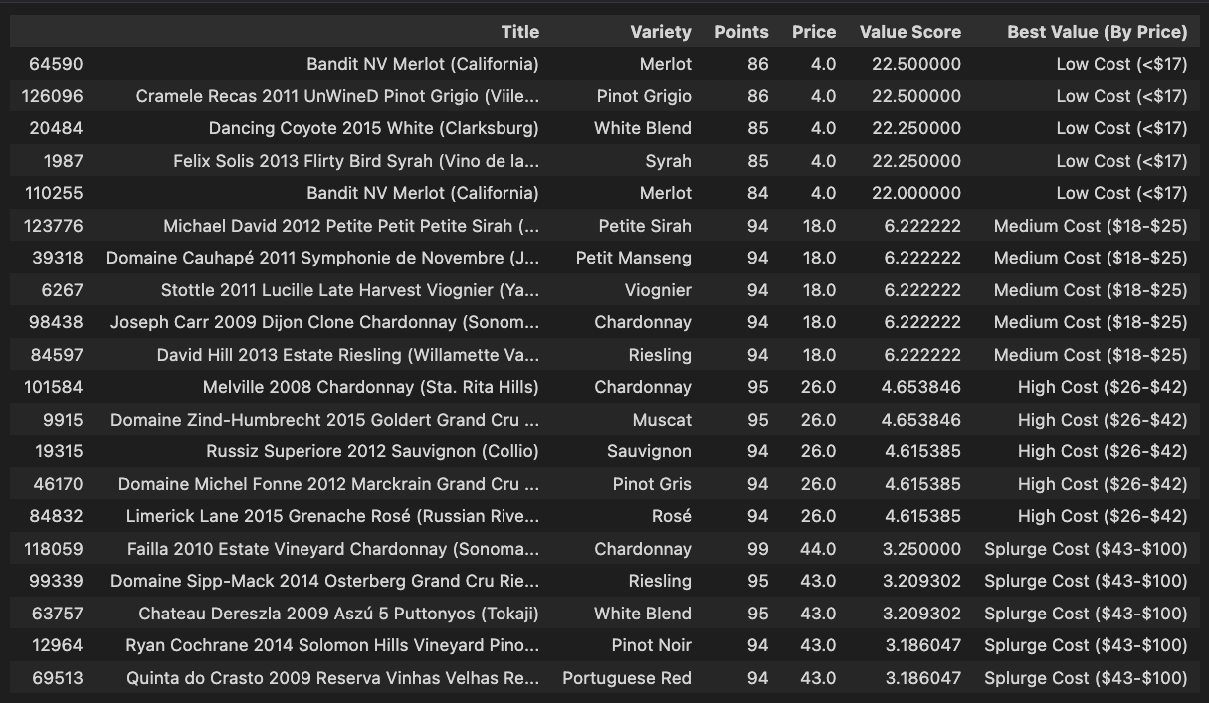
Best value wines (By Price Point)
Value Score = (Points+Price)/Price
Low Cost (<$17
Medium Cost ($18-$25)
High Cost ($26-$42)
Splurge Cost ($43-$100)
Wine ratings:
80-84 (Good)
85-89 (Very good)
90-94 (Outstanding)
95-100 (Classic)

Slide 5
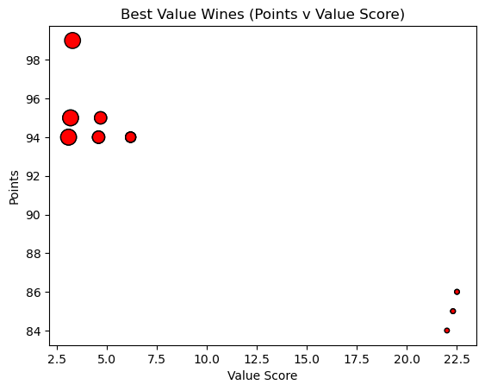
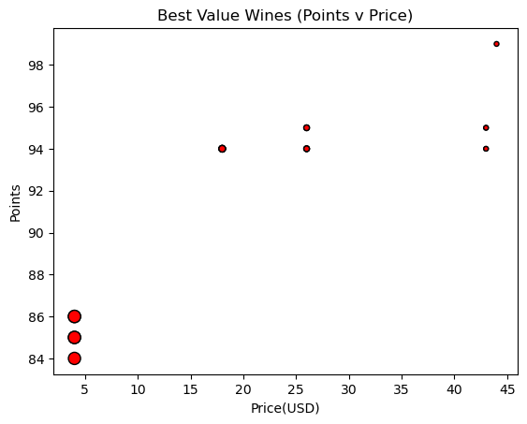
Best Value wine - scatterplot

Slide 6
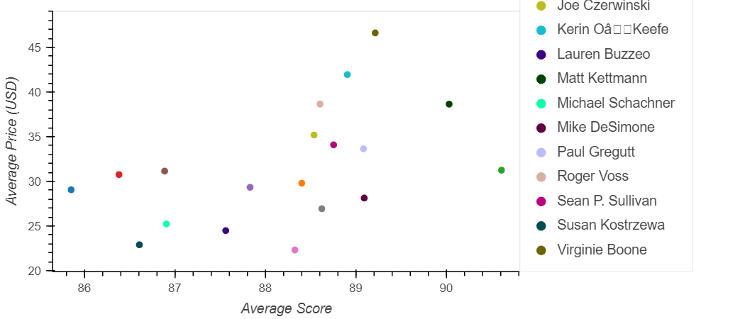
Reviewer avg score vs price

Slide 7
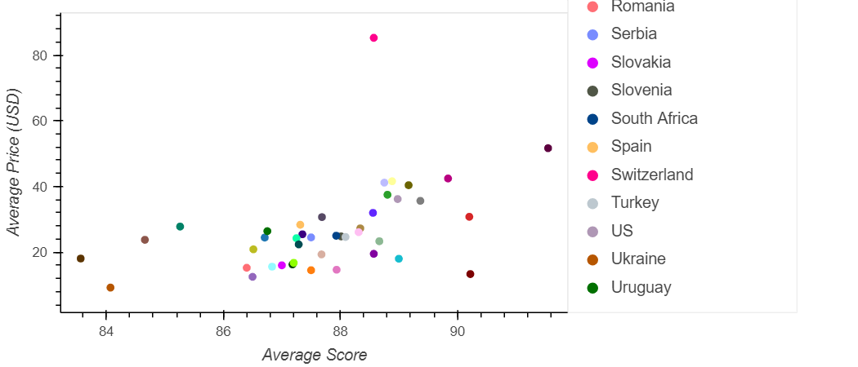
Country avg score vs price

Slide 8
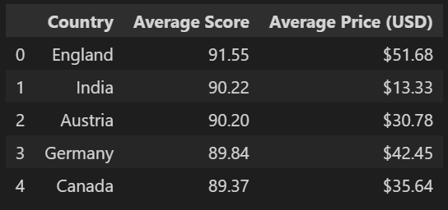
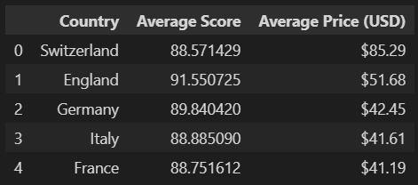
Top 5 Highest rated Countries
Top 5 Expensive countries

Slide 9
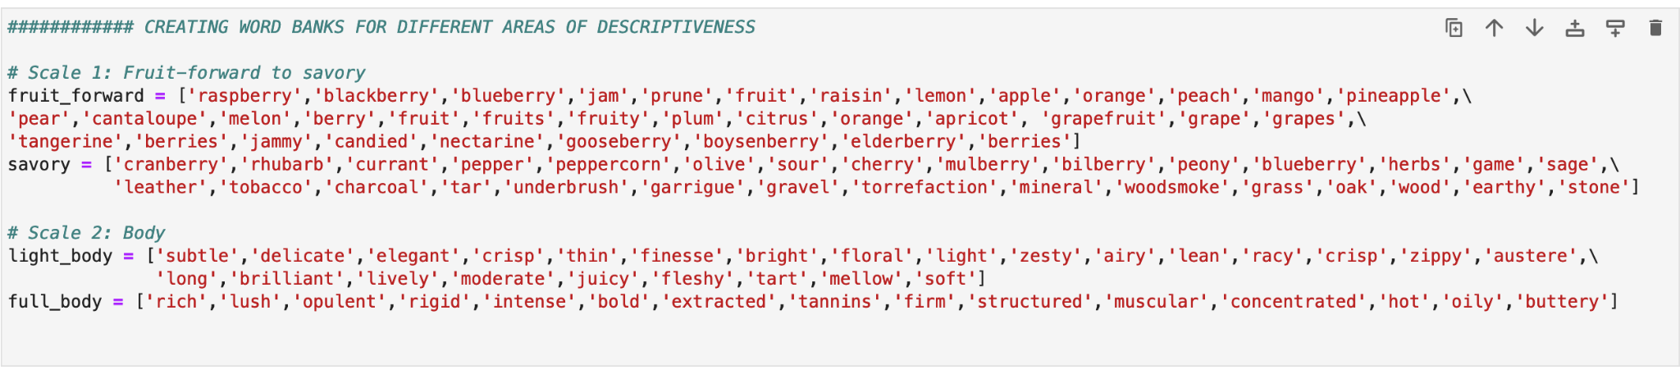
Wine tasting categories and scales
Words from: https://winefolly.com/deep-dive/wine-tasting-terms-to-use/
Notes:
Created lists of words that are used to describe different aspects of wine tasting
The fruit level - on a scale from savory to fruit forward
The body - on a scale from light to full bodied

Slide 10
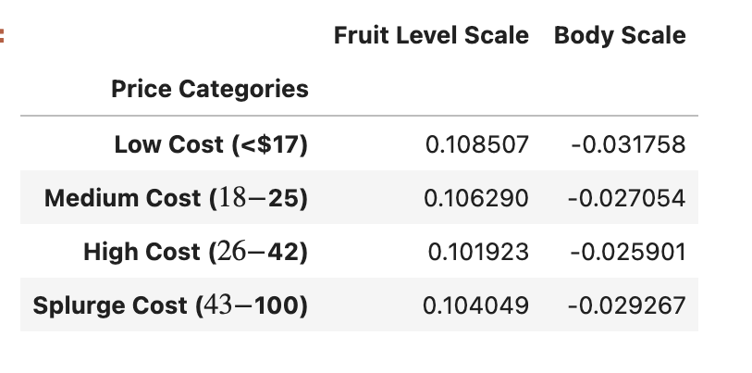
Price bins and fruit level/body scale
Mean flavor profile value and body scale value show no meaningful difference at different price categories

Slide 11
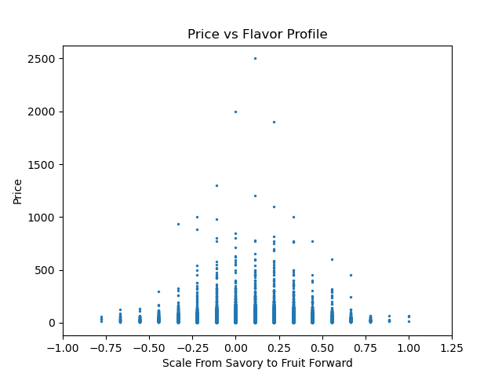
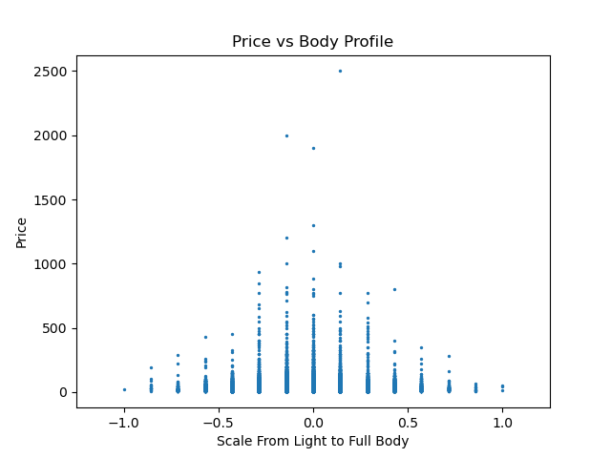
Fruit Level and Body Profile vs Price
Generally appears that wines with more extreme flavor profiles are cheaper.
Generally appears that wines with more extreme body profiles are cheaper.

Slide 12
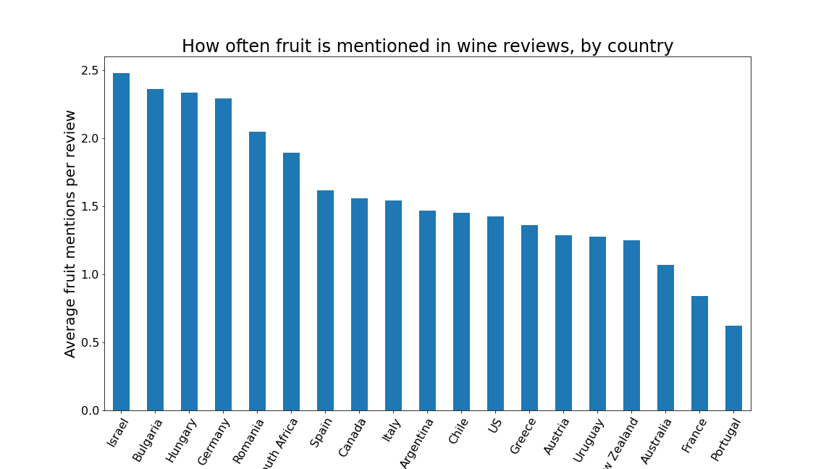
What fruit flavors are most prominent among wines from the countries with the fruitiest wines?
I wrote up a script to comb through wine reviews and count instances of unique words.
Unsurprisingly, I discovered that wine tasters talk a lot about fruit.
I counted the number of times fruits were mentioned in each wine review and divided that by the number of wine reviews to get a sort of "average fruit per wine" number for each country of origin, which I've decided to call "Fruitiness."
Which countries of origin are responsible for which fruit flavors in their wine?

Slide 13
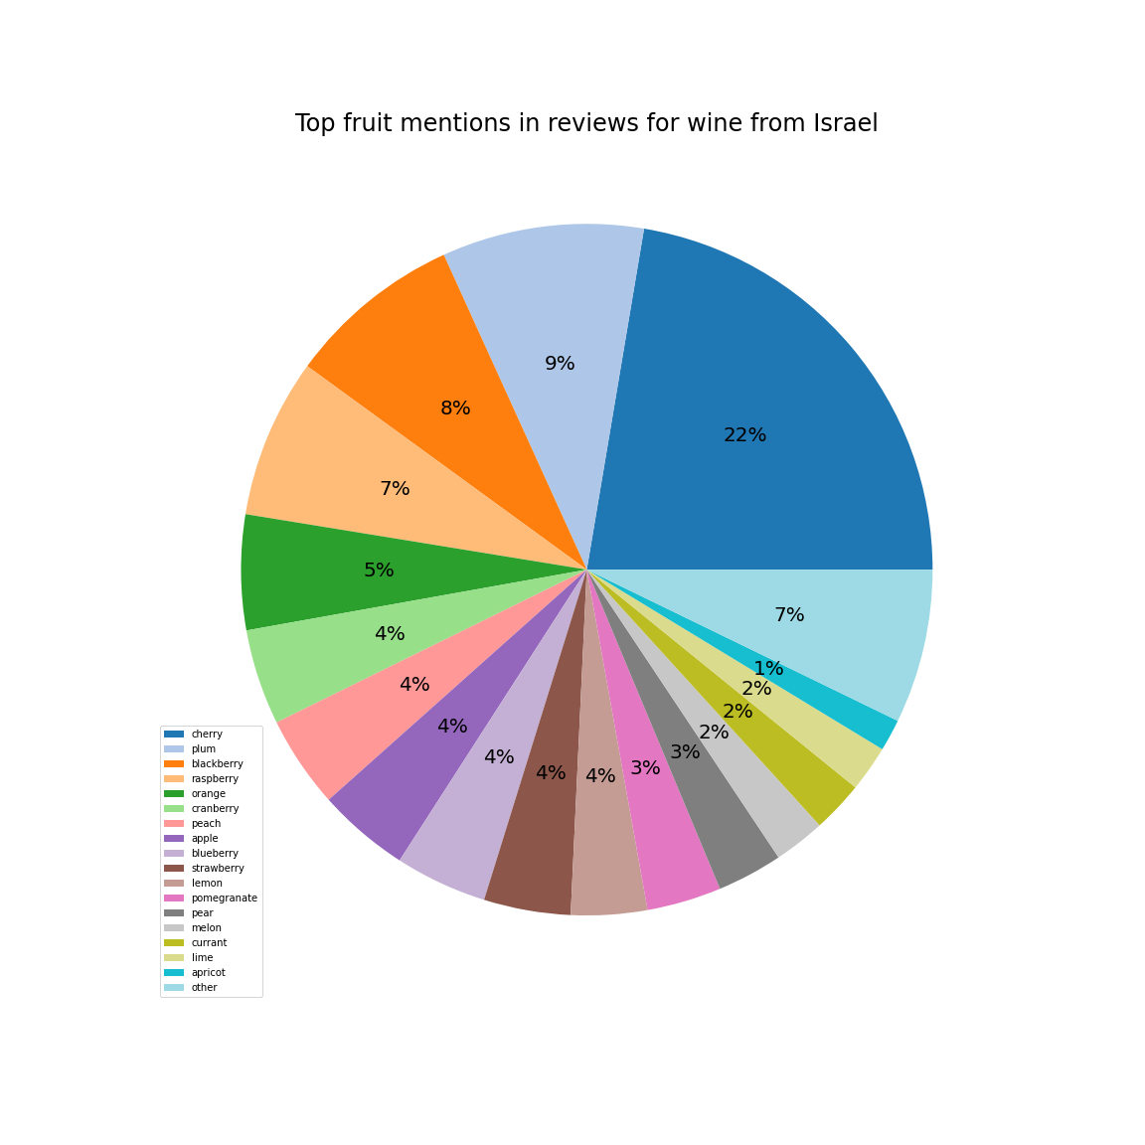
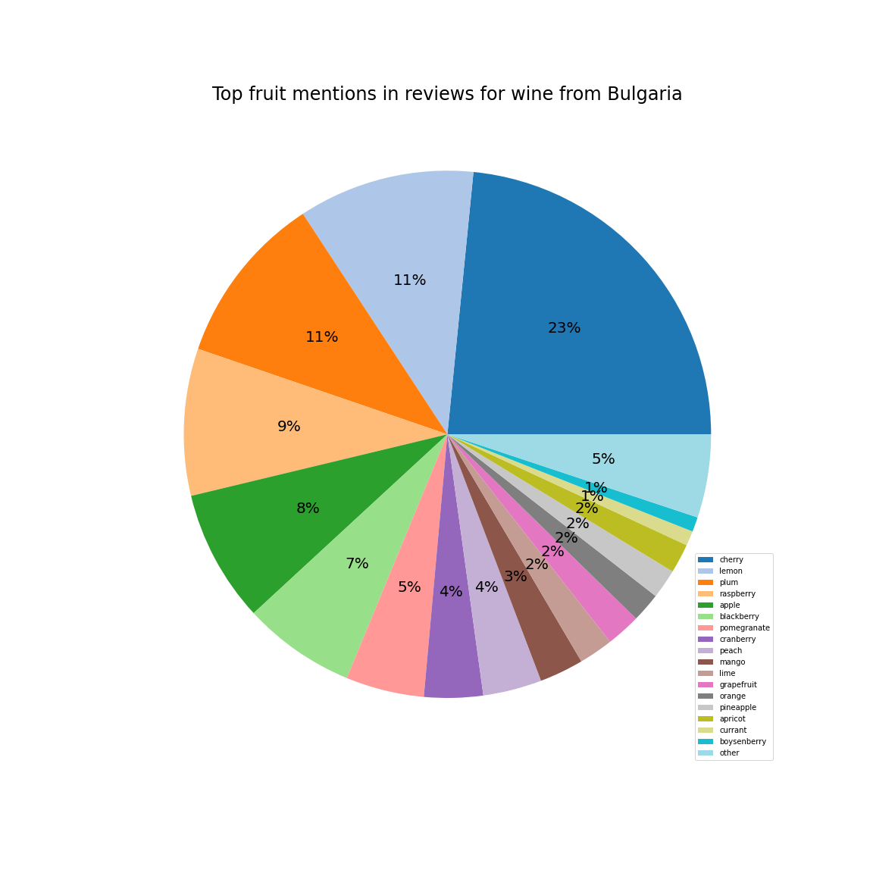
Top flavors for the countries with the fruitiest wine
Israel
Bulgaria
Features berry notes
Cherry also common
Stone fruits dominant
Lemon!?

Slide 14
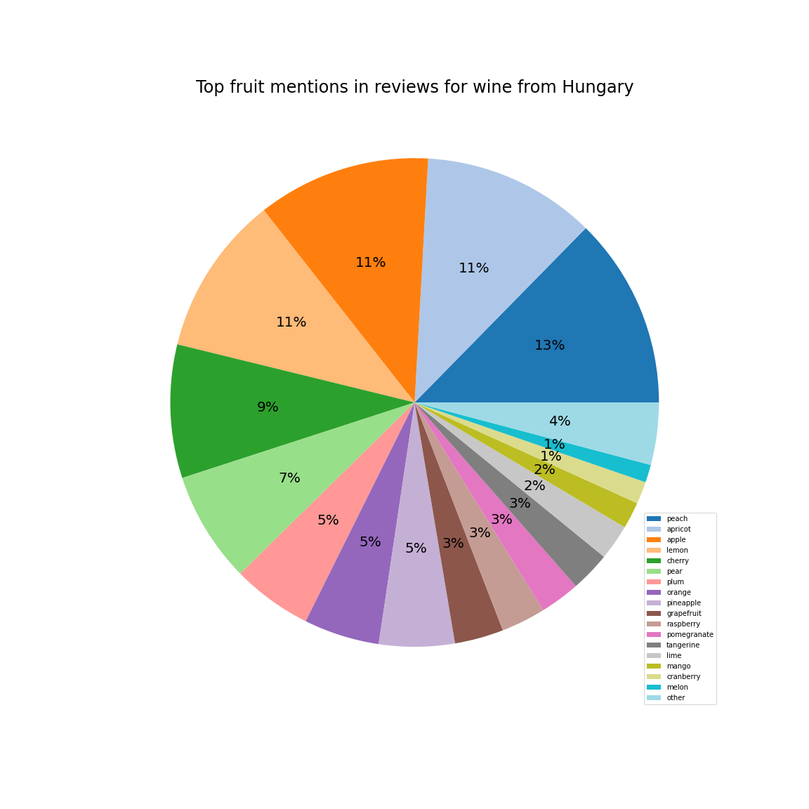
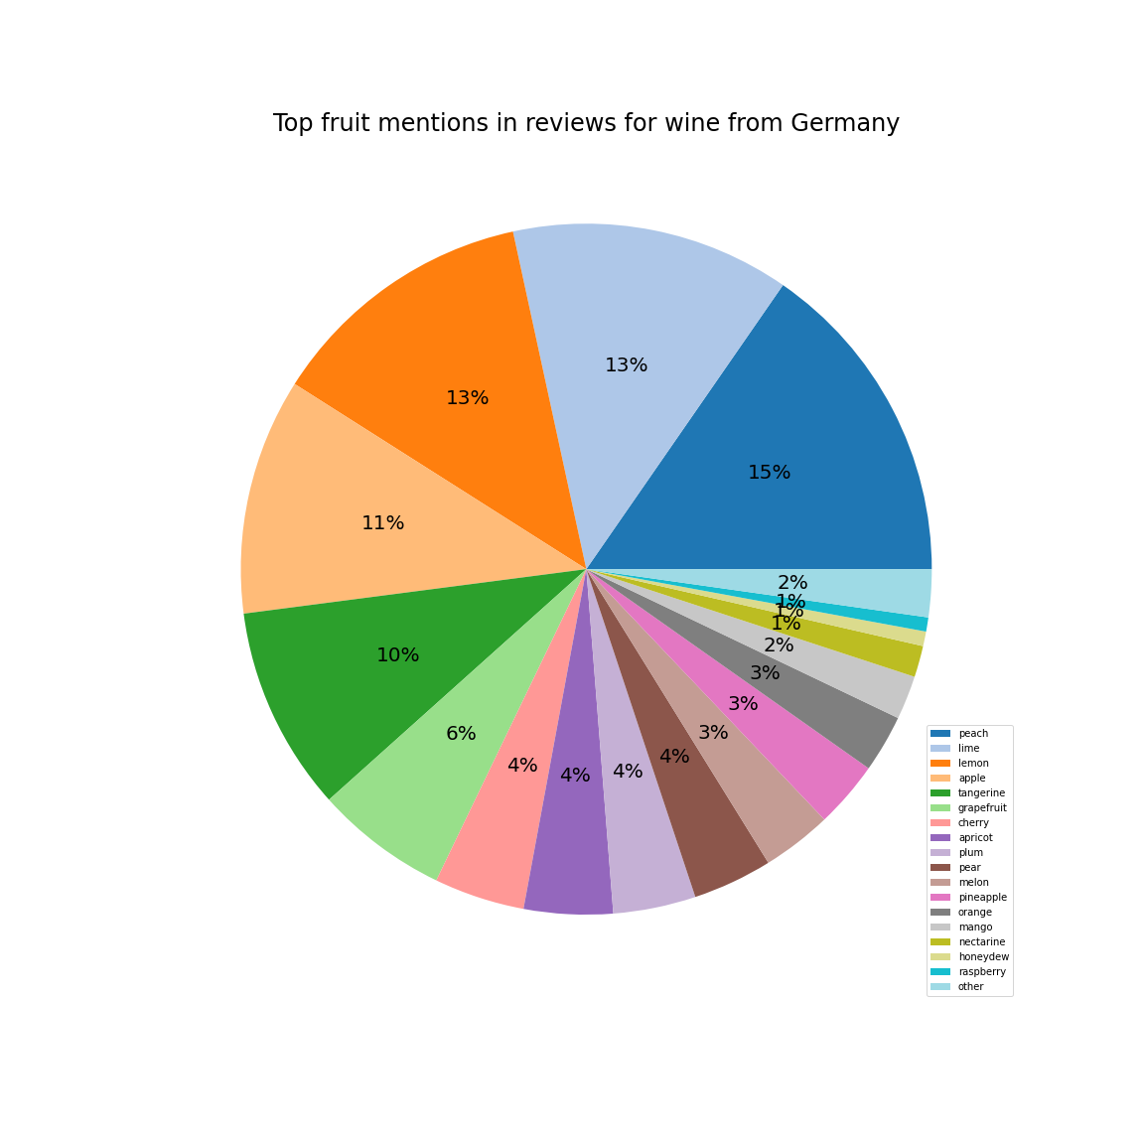
Top flavors for the countries with the fruitiest wine
Hungary
Germany
Diversity of fruits
Pomes unusually common
Citrus reigns supreme
Peach, but not other drupes

Slide 15
Flavor Summary
Israel: Berries
Bulgaria: Stone Fruits
Hungary: Variety
Germany: Citrus

Slide 16
Conclusions on Overall analysis
Great wine is possible to purchase for as little as $4
Spending over $43 on wine is generally not worth it as scoring in the $26 to $42 range is comparable
The top 5 highest scored countries are England(91.22), India(90.22), Austria(90.20), Germany(89.84), and Canada(89.37).
Top 5 most expensive countries Switzerland(85.29), England(51.68), Germany(42.45), Italy(41.61), and France(41.19)
No significant difference mean in flavor profile value and body scale value for different price levels
Appears that the most wines extreme in flavor or body are generally the cheapest
If you want berry flavors, import from Israel. If you're more into stone fruits, you could honestly shop anywhere, but they're the most common in Bulgaria. If citrus is your thing, check out German wine. If you're open to a variety of fruity experiences, check out Hungarian wine.

